Slide 1
The Midterm Elections
How They May Impact Your Business in 2018 and Beyond
November 8, 2018

Slide 2
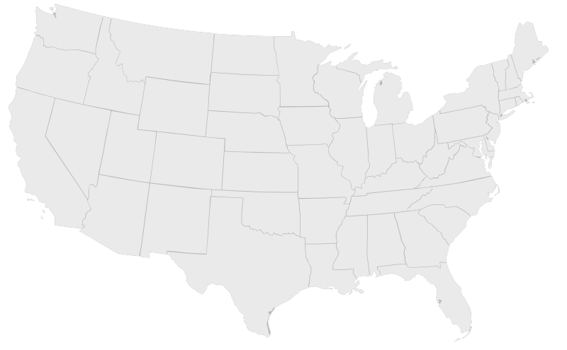
Overview of Manatt
Manatt, Phelps & Phillips, LLP is a multidisciplinary, integrated national professional services firm known for quality and an extraordinary commitment to clients. We are keenly focused on specific industry sectors, providing legal and consulting capabilities at the very highest levels to achieve our clients’ business objectives.
At-a-Glance
Over 450 professionals and consultants
Legal services including:
Corporate & Transactions
Government & Regulatory
Intellectual Property
Litigation
Industry-focused:
Advertising, Marketing & Media
Consumer Products
Energy, Environment & Natural Resources
Entertainment & Digital Media
Financial Services
Healthcare and Pharmaceutical
Real Estate
Technology
Albany
Sacramento
New York
San Francisco
Chicago
Palo Alto
Washington D.C.
Los Angeles
Orange County
= Manatt Locations

Slide 3
Introduction
Jack Quinn
Partner, Government and Regulatory
jquinn@manatt.com
Gregg Nunziata
Partner, Government and Regulatory
gnunziata@manatt.com
Jack Quinn is a partner in both the government and litigation practices and serves as chair of the federal regulatory and government practice. He also assists clients in navigating governmental investigations and provides strategic crisis-management advice. Clients routinely turn to Jack for help addressing the challenges—and opportunities—at the intersection of law, public policy, politics and communications.
Jack served as Counsel to the President of the United States. In that role, he counseled President Clinton and senior White House staff on the legal aspects of policy and legislation; investigations undertaken by both independent counsel and congressional committees; Executive actions and appointments; judicial nominations; financial disclosures and conflicts of interest; and certain national security issues that require legal advice. At the time of his appointment as White House Counsel, Jack was Chief of Staff and Counselor to Vice President Al Gore. Jack also practiced law at an Am Law 100 firm for more than 20 years.
Gregg Nunziata advises clients on matters at the intersection of law, business, public policy and strategic communications. He counsels businesses—including those involved in high-profile litigation and company-defining transactions—on how they may potentially be affected by shifts in public policy, and guides clients on legislative issues and in response to government inquiries.
Gregg served as general counsel and a senior domestic policy advisor to Sen. Marco Rubio, including during the senator’s presidential and reelection campaigns. Gregg previously held senior Republican counsel positions on Capitol Hill, handling a range of domestic policy issues. A former chief nominations counsel to the U.S. Senate Committee on the Judiciary, Gregg played a key strategic role in the confirmation proceedings for scores of federal judges and executive branch appointees, including Chief Justice John Roberts, Associate Justice Samuel Alito and Attorney General Michael Mukasey. Gregg also served as the founder of a public policy tech startup and as senior director of a healthcare consulting firm.

Slide 4
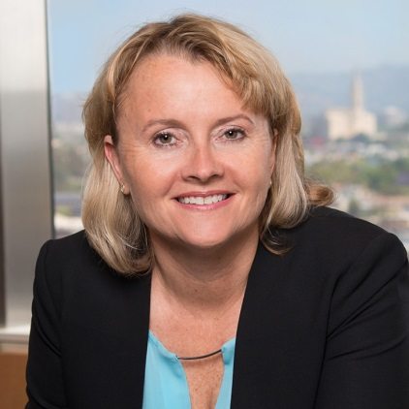
Introduction
Chiquita Brooks-LaSure
Managing Director, Manatt Health
Cbrooks-lasure@manatt.com
Brian Korn
Co-chair, Financial Services Group
bkorn@manatt.com
David Huard
Co-chair, Energy
dhuard@manatt.com
Brandon Reilly
Associate, Privacy and Data Security
breilly@manatt.com
Donna Wilson
Managing Partner-Elect, Privacy and Data Security
dlwilson@manatt.com

Slide 5
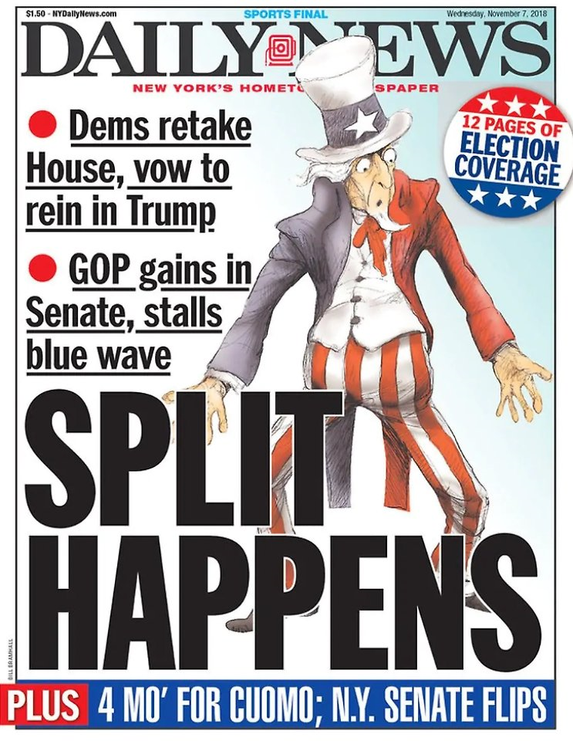
Results Overview
No huge surprises
Everyone has something to be happy about
Senate Republicans gain seats
House Democrats get gavels
While results show some vulnerability in Trump’s base, he proved he can singlehandedly make the difference in some states
State-by-state, exit polls matched closely with Trump approval and disapproval ratings

Slide 6
Agenda
Welcome
House Results – Democrats take over
Senate Results – Republicans hold
Governor/State Legislature Roundup
Industry-specific Considerations
Healthcare Financial Services Energy
Policy Spotlights Trade and Tariffs Privacy and Data Security Oversight and Investigations
Q&A/Wrap-Up

Slide 7
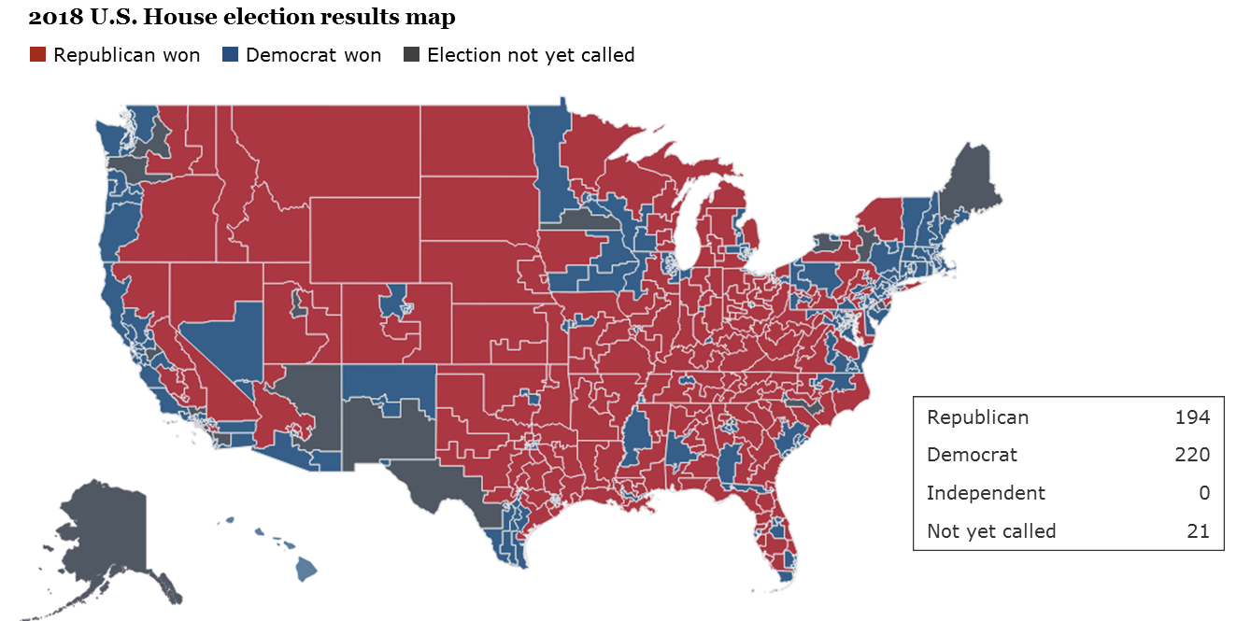
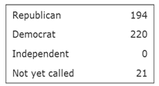
House Results – Democrats take over
When all votes are counted, the Democratic Party will likely pick up between 35 and 40 seats
Democrats made gains in the suburbs, rural areas still strongly Republican
Areas of concern in the Midwest: Pennsylvania, Michigan, Wisconsin, Iowa
For the first time, the administration will have to deal with an antagonistic House: gridlock or opportunity?

Slide 8
Competitive House Races
Likely Dem | Lean Dem | Toss Up | Lean Rep | Likely Rep
AZ-01 O'Halleran | AZ-02 Open | *CA-10 Denham | AK-AL Young | AR-02 Hill
CA-07 Bera | CA-49 Open | CA-25 Knight | CA-50 Hunter | AZ-06 Schweikert
CA-16 Costa | CO-06 Coffman | *CA-39 Open | FL-06 Open | AZ-08 Lesko
FL-07 Murphy | FL-27 Open | *CA-45 Walters | FL-16 Buchanan | CA-01 LaMalfa
MN-07 Peterson | IA-01 Blum | CA-48 Rohrabacher | FL-18 Mast | CA-04 McClintock
NH-01 Open | IL-06 Roskam | FL-15 Open | GA-06 Handel | CA-21 Valadao
NJ-02 Open | KS-03 Yoder | FL-26 Curbelo | *GA-07 Woodall | CA-22 Nunes
NJ-05 Gottheimer | MI-11 Open | IA-03 Young | IA-04 King | CO-03 Tipton
PA-05 Vacant | MN-02 Lewis | IL-14 Hultgren | IL-12 Bost | FL-25 Diaz-Balart
PA-06 Open | MN-03 Paulsen | KS-02 Open | IL-13 Davis | IN-02 Walorski
PA-08 Cartwright | NJ-11 Open | KY-06 Barr | MN-08 Open | MI-01 Bergman
PA-17 Rothfus | NV-03 Open | *ME-02 Poliquin | MO-02 Wagner | MI-03 Amash
 | NV-04 Open | MI-08 Bishop | MT-AL Gianforte | MI-06 Upton
 | PA-07 Vacant | MN-01 Open | NC-02 Holding | MI-07 Walberg
 | VA-10 Comstock | *NC-09 Open | NE-02 Bacon | NC-08 Hudson
 |  | NC-13 Budd | NY-11 Donovan | NY-01 Zeldin
 |  | NJ-03 MacArthur | NY-24 Katko | NY-02 King
Not yet called* |  | NJ-07 Lance | NY-27 Collins | NY-21 Stefanik
 |  | NM-02 Open | OH-01 Chabot | NY-23 Reed
 |  | NY-19 Faso | PA-10 Perry | OH-10 Turner
 |  | NY-22 Tenney | PA-16 Kelly | OH-14 Joyce
 |  | OH-12 Balderson | SC-01 Open | OK-05 Russell
 |  | PA-01 Fitzpatrick | TX-22 Olson | PA-14 Open
 |  | TX-07 Culberson | *TX-23 Hurd | TX-02 Open
 |  | TX-32 Sessions | VA-05 Open | TX-21 Open
 |  | UT-04 Love | WA-03 Herrera Beutler | TX-24 Marchant
 |  | VA-02 Taylor | WA-05 McMorris Rodgers | TX-31 Carter
 |  | VA-07 Brat | WI-01 Open | WI-06 Grothman
 |  | WA-08 Open | WV-03 Open
Democratic Pickup
Republican Pickup
No Change
Race Ratings from Cook Political Report
Notes:
This slide is a good demonstration of the expected House results vs. what actually happened. As you can see, things went pretty much to plan. Some surprises (SC-01, OK-5, NY-11), but most results tracked with the most recent polling.

Slide 9
House Results
Will there be leadership changes in the House Democratic Caucus?
What might the legislative agenda consist of?
Infrastructure bill
Immigration
Criminal justice reform
Drug pricing
Messaging bill agenda
Will Democrats gamble and put big-ticket progressive items like “Medicare for All” on the floor?
Oversight agenda
Appropriations

Slide 10
House Results – Likely New House Committee Chairs
Eddie Bernice Johnson (Texas) Sci., Space & Tech.
Zoe Lofgren (Calif.) House Admin.
Nita Lowey (N.Y.) Appropriations
Carolyn Maloney (N.Y.) Joint Economic
Nydia Velázquez (N.Y.) Small Business
Maxine Waters (Calif.) Financial Services
Elijah Cummings (Md.) Oversight & Government Reform
Peter DeFazio (Ore.) Transport. & Infra.
Ted Deutch (Fla.) Ethics
Eliot Engel (N.Y.) Foreign Affairs
Raúl Grijalva (Ariz.) Natural Resources
Jim McGovern (Mass.) Rules
Jerrold Nadler (N.Y.) Judiciary
Richard Neal (Mass.) Ways & Means
Frank Pallone (N.J.) Energy & Comm.
Collin Peterson (Minn.) Agriculture
Adam Schiff (Calif.) Intelligence
Bobby Scott (Va.) Edu. & Workforce
Adam Smith (Wash.) Armed Services
Mark Takano (Calif.) Veterans’ Affairs
Bennie Thompson (Miss.) Homeland Security
John Yarmuth (Ky.) Budget
Rep. Waters is widely seen as a “foe” to Wall Street and has called for increased regulations on big banks.
Cummings will lead the way in investigations of the White House. During 115th, he has requested at least 64 subpoenas that the majority rejected.
Nadler has indicated that his committee will investigate family separation, gun safety, environmental laws and the DOJ’s failure to defend the Affordable Care Act
Democrats ran hard against the Republican tax bill. Will they work to put their own plan on the floor despite knowing that the Senate won’t act?

Slide 11
Agenda
Welcome
House Results – Democrats take over
Senate Results – Republicans hold
Governor/State Legislature Roundup
Industry-specific Considerations
Healthcare Financial Services Energy
Policy Spotlights Trade and Tariffs Privacy and Data Security Oversight and Investigations
Q&A/Wrap-Up

Slide 12
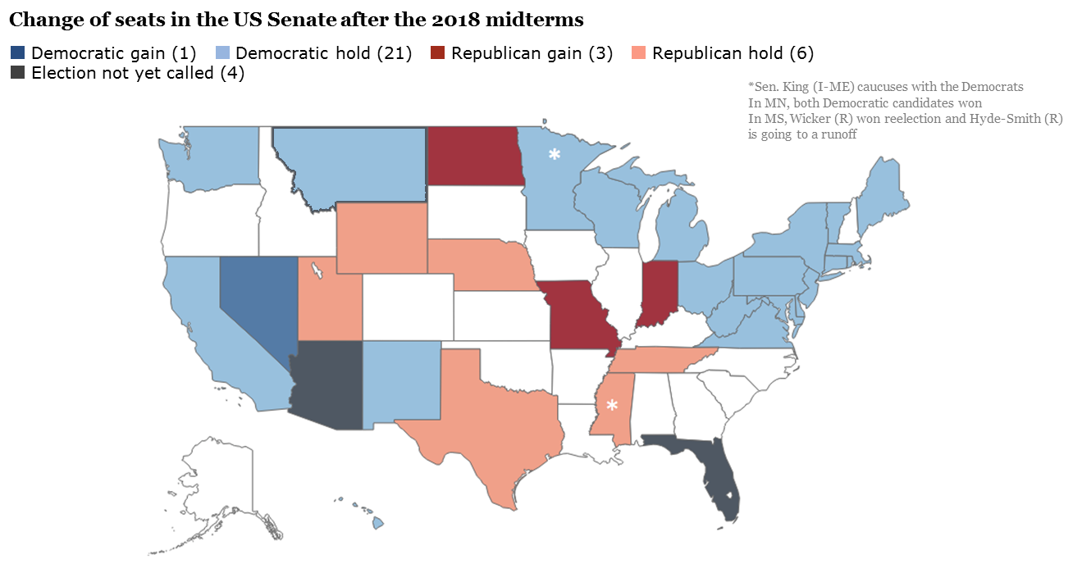
Senate Results – Republicans hold
Favorable results for the Republicans
10 states that President Trump won
An expanded majority and what that means
3

Slide 13
Senate Results
Safe D | Likely D | Lean D | Toss Up | Lean R | Likely R | Safe R
CA-Feinstein | MI-Stabenow | MN-Smith | FL-Nelson | ND-Heitkamp |  | MS-Wicker
CT-Murphy | OH-Brown | WV-Manchin | IN-Donnelly | MS-Hyde-Smith |  | NE-Fischer
DE-Carper | PA-Casey |  | MO-McCaskill |  |  | UT-Open
HI-Hirono | WI-Baldwin |  | MT-Tester |  |  | WY-Barrasso
MA-Warren |  |  | NJ-Menéndez
MD-Cardin |  |  | AZ-Open
ME-King |  |  | NV-Heller
MN-Klobuchar |  |  | TN-Open
NM-Heinrich |  |  | TX-Cruz
NY-Gillibrand
RI-Whitehouse
VA-Kaine
VT-Sanders
Race Ratings from Cook Political Report

Slide 14
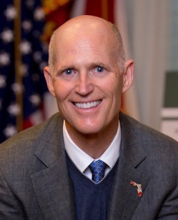
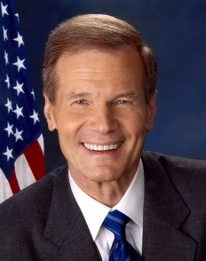
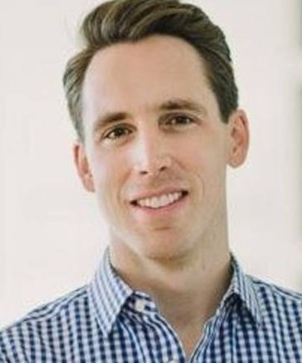
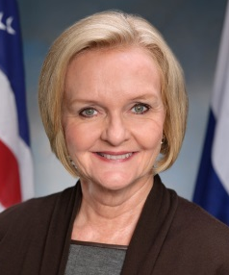
Senate Highlights – Republican Flips
Florida (Recount)
Rick Scott | Bill Nelson
Vote Share: 50.2% | Vote Share: 49.8%
Indiana
Mike Braun | Joe Donnelly
Vote Share: 53% | Vote Share: 43%
Missouri
Josh Hawley | Claire McCaskill
Vote Share: 51.5% | Vote Share: 45.5%
North Dakota
Kevin Cramer | Heidi Heitkamp
Vote Share: 55.4% | Vote Share: 44.6%

Slide 15
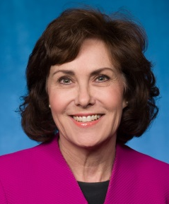
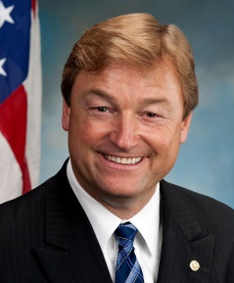
Senate Highlights – Democratic Flips
Nevada
Jacky Rosen | Dean Heller
Vote Share: 50.4% | Vote Share: 45.4%

Slide 16
Senate Results
Leadership changes
Beyond McConnell, the whole Republican leadership team is term-limited out
New committee leadership
Even though the Republicans are retaining control, there will be significant changes in leadership
Legislative agenda
Judicial confirmations
Tariffs (steel, aluminum, China), sanctions on Saudi Arabia, infrastructure, criminal justice reform, drug pricing, immigration
Weakness in the Great Lakes states: a warning sign for President Trump?
Oversight agenda

Slide 17
Senate Results – Potential Senate Committee Chairs/Ranking Members
Susan Collins (ME) Aging Bob Casey Jr. (PA) | Pat Roberts (KS) Agriculture, Nutrition & Forestry Debbie Stabenow (MI) | Richard Shelby (AL) Appropriations Patrick Leahy (VT) | Jim Inhofe (OK) Armed Services Jack Reed (RI)
Mike Crapo (ID)/ Pat Toomey (PA) Banking, Housing & Urban Development Sherrod Brown (OH) | Mike Enzi (WY) Budget Bernie Sanders (VT) | John Thune (SD)/ Roger Wicker (MS) Commerce, Science & Transportation Bill Nelson (FL)/ Maria Cantwell (WA) | Lisa Murkowski (AK) Energy & Natural Resources Maria Cantwell (WA)
John Barrasso (WY) Environment & Public Works Tom Carper (DE) | Johnny Isakson (GA) Ethics Christopher Coons (DE) | Chuck Grassley (IA)/ Mike Crapo (ID) Finance Ron Wyden (OR) | Jim Risch (ID)/ Marco Rubio (FL) Foreign Relations Bob Menendez (NJ)
Lamar Alexander (TN) Health, Education, Labor & Pensions (HELP) Patty Murray (WA) | Ron Johnson (WI) Homeland Security & Government Affairs Tom Carper (DE) | John Hoeven (ND) Indian Affairs Tom Udall (NM) | Richard Burr (NC) Intelligence Mark Warner (VA)
Chuck Grassley (IA)/ Lindsay Graham (SC) Judiciary Dianne Feinstein (CA) | Roy Blunt (MO) Rules & Administration Amy Klobuchar (MN) | Jim Risch (ID)/ Marco Rubio (FL) Small Business & Entrepreneurship Jeanne Shaheen (NH) | Johnny Isakson (GA) Veterans’ Affairs Jon Tester (MT)

Slide 18
Agenda
Welcome
House Results – Democrats take over
Senate Results – Republicans hold
Governor/State Legislature Roundup
Industry-specific Considerations
Healthcare Financial Services Energy
Policy Spotlights Trade and Tariffs Privacy and Data Security Oversight and Investigations
Q&A/Wrap-Up

Slide 19
Governors/State Legislatures Roundup
There were gubernatorial elections in thirty-six states formerly held by 26 Republicans, 9 Democrats and 1 Independent. Democrats appear to have picked up 7.
As of Wednesday afternoon, the DLCC reported that 367 seats had flipped across the country. The Democrats lost more than 900 seats in state legislatures during Obama’s eight years in office.
Democrats flipped state legislative chambers in seven states.
Florida
Ron DeSantis
vs. Andrew Gillum
Georgia
Brian Kemp
vs. Stacey Abrams
Wisconsin
Scott Walker
vs. Tony Evers
Iowa
Kim Reynolds
vs. Fred Hubbell
Ohio
Mike DeWine
vs. Richard Cordray
California
John Cox
vs. Gavin Newsom
Michigan
Bill Schuette
Vs. Gretchen Whitmer
New York
Marc Molinaro
vs. Andrew Cuomo
Maine
Shawn Moody
Vs. Janet Mills
Kansas
Kris Kobach
vs. Laura Kelly

Slide 20
Governors/State Legislatures Roundup (con’t)
Federal implications
Medicaid expansion
Redistricting implications post 2020 census
Democrats gain a majority of state attorney general offices
Ballot initiatives
Florida’s voter rights restoration measure.
1.5 million people with felony convictions can now cast a ballot.
California: Gas tax and rent control both fail.
Cannabis: Utah, Michigan and Missouri vote yes. North Dakota says no.
A Jim Crow relic (non-unanimous jury verdicts) goes down in Louisiana.
Voting rights advocates score victories in Colorado, Michigan, Maryland, Missouri and Nevada.
Minimum wage hikes in Arkansas and Missouri.

Slide 21
Agenda
Welcome
House Results – Democrats take over
Senate Results – Republicans hold
Governor/State Legislature Roundup
Industry-specific Considerations
Healthcare Financial Services Energy
Policy Spotlights Trade and Tariffs Privacy and Data Security Oversight and Investigations
Q&A/Wrap-Up

Slide 22
What Do the Midterm Elections Mean for Healthcare?
On November 15, Manatt Health will present a deep dive webinar on how the midterm election results will impact national and state health policy
House flip means a shift in health care priorities
Limited federal legislation addressing Rx pricing and supporting the ACA possible
State-level election results are significant for health policy, particularly Medicaid expansion
Four key areas at play – federally and at the state level – in the coming year:
Medicaid
Individual Market
Health Reform
Drug Pricing

Slide 23
Financial Services
Composition of key financial services banking committees
Federal Reserve leadership changes and impact on key interest rates
Implications for financial services regulators
Impact on special purpose fintech charters
Effect of Colorado and New York governors on fintech
Prognosis for marketplace lending
Notes:
What does the election mean for the composition of key Senate and House financial services and banking committees? (If the Dems win the Senate) Will we see more bank CEOs called to testify?
What ongoing rulemaking might be helped/hurt by the midterm results?
What is the prognosis for the Federal Reserve leadership and key interest rates? Will the Fed continue its rate hike?
(If the Dems win the House) Will the CFPB have more teeth and will there be legislative changes to make the CFPB a more effective regulator? What about the OCC’s ability to implement special purpose fintech charters?
What’s the prognosis for marketplace lending in the next two years? The industry has some allies in both sides of the aisle, what can we look for in the next term?
A key takeaway here is that some things might get passed or tweaked, but compromise will be the order of the day. Rulemaking has been very quiet in DC other than cutting the corporate tax rate to 21%, and the states are making the most noise on the enforcement side. 2020 is obviously a bigger moment and everyone will be speculating in the run up to 2020.

Slide 24
Energy
New leadership on energy and commerce will be:
Frank Pallone from New Jersey
Raul Grijalva of New Mexico will likely lead the Natural Resources Committee
Anna Eschoo of California will chair important subcommittees
With the Democrats taking over the House, we can expect three things:
Subpoenas for investigations
Hearings on many issues being addressed by key agencies to slow down the Trump agenda
Possibly an effort to bring climate change issues more to the front
Notes:
Will the election lead to a change in policy at FERC, DOE, EPA or the Interior Department on carbon emitting energy sources and climate control efforts; especially the use of coal for electric generation?
What has been the reaction of the States to Trump energy and environmental policies in the election – Washington carbon tax, AZ and NV 50% renewables initiatives, Colorado limit on fracking, SLO county initiative to effectively eliminate oil and gas production?
Will we see an increase in DAGA (Democratic Attorneys General Association) suits against the administration or the relevant energy and environmental agencies as we saw a huge increase in RAGA suits after the GOP gained control of the Senate under the Obama administration (e.g., Scott Pruitt)?
Could there be an effect on the current trade and tariff wars – especially the global energy trade -- as a result of the elections?

Slide 25
Energy
The states reactions to energy policy in this election were decidedly mixed.
Colorado defeated an initiative to require a step back from homes for any energy development
Washington’s carbon tax initiative was soundly crushed with the press blaming huge oil company investment in the effort
Nevada passed a 50% RPS requirement with electric market deregulation elements
Arizona rejected the 50% RPS requirement
The local level also saw mixed results, with a California county’s attempt to ban fracking and oil development appearing to have been safely defeated
Notes:
Will the election lead to a change in policy at FERC, DOE, EPA or the Interior Department on carbon emitting energy sources and climate control efforts; especially the use of coal for electric generation?
What has been the reaction of the States to Trump energy and environmental policies in the election – Washington carbon tax, AZ and NV 50% renewables initiatives, Colorado limit on fracking, SLO county initiative to effectively eliminate oil and gas production?
Will we see an increase in DAGA (Democratic Attorneys General Association) suits against the administration or the relevant energy and environmental agencies as we saw a huge increase in RAGA suits after the GOP gained control of the Senate under the Obama administration (e.g., Scott Pruitt)?
Could there be an effect on the current trade and tariff wars – especially the global energy trade -- as a result of the elections?

Slide 26
Agenda
Welcome
House Results – Democrats take over
Senate Results – Republicans hold
Governor/State Legislature Roundup
Industry-specific Considerations
Healthcare Financial Services Energy
Policy Spotlights Trade and Tariffs Privacy and Data Security Oversight and Investigations
Q&A/Wrap-Up

Slide 27
Trade and Tariffs
Where do Sect. 232 and 301 tariffs go from here?
Will the Trump Administration impose automotive tariffs on the E.U.?
USMCA (NAFTA 2.0): Prospects for passage
Agreement will likely be signed by U.S., Canada, and Mexico on November 30.
Post-signing, White House has 60 days to submit report to Congress on what changes to U.S. law are required.
Concurrently, the International Trade Commission (ITC) has 105 days to complete a study of the agreement’s economic impact. The ITC does not have to take the full time, but it has in the past.
The administration must also submit its Statement of Administrative Action (SAA) along with the final legal text of the agreement 30 days before giving Congress implementing language.
Once Congress has a bill, it has 90 legislative days to act on it under TPA. Once the House passes it, the Senate has 30 days to consider the bill.
While it is technically possible for the 115th Congress to act to pass implementing language before adjourning on January 3, it is highly likely that final approval of NAFTA 2.0 will fall to the next Congress.
Tariffs and trade policies
Will a change in the Senate impact the ease with which treaties and trade agreements are ratified?

Slide 28
Privacy and Data Security
Activity continues to emanate from two major 2018 developments:
Cambridge Analytica revelations
GDPR
Prospects for federal privacy legislation
CCPA and beyond: Role of existing and future state legislation
Is cyber security taking the backseat?
Net neutrality
Notes:
What are the prospects of Congress passing a federal data privacy law in the next term?
Do you see a Democrat-controlled House as more or less likely to focus on privacy and data security issues? [not applicable if majority doesn’t switch]
Does the new governorship in California increase or decrease the likelihood of meaningful changes to the CCPA?

Slide 29
Oversight and Investigations
House Democratic investigations will be targeted at:
The Trump administration (Comey firing, child separation, security clearances, cabinet secretaries)
Trump businesses (emoluments, fraud, foreign investments)
Trump himself (tax returns, etc.)
Industries and companies that have been the beneficiaries of controversial initiatives on behalf of the administration
House OGR, Judiciary, and Ways and Means will lead the investigations trend, but nearly every other committee could be involved as well
The Mueller Probe:
Mueller’s conclusion will be embodied in a report that will go to the AG – if one is confirmed by the time Mueller is ready to proceed – or the acting AG
The AG can choose to release to Congress and the public or do nothing with it
If the DOJ doesn’t release, a Democratic House could subpoena its release
While some believe that executive privilege may be invoked over the report, we do not

Slide 30
Agenda
Welcome
House Results – Democrats take over
Senate Results – Republicans hold
Governor/State Legislature Roundup
Industry-specific Considerations
Healthcare Financial Services Energy
Policy Spotlights Trade and Tariffs Privacy and Data Security Oversight and Investigations
Q&A/Wrap-Up

Slide 31
Wrap Up
Q
A

